Slide 1

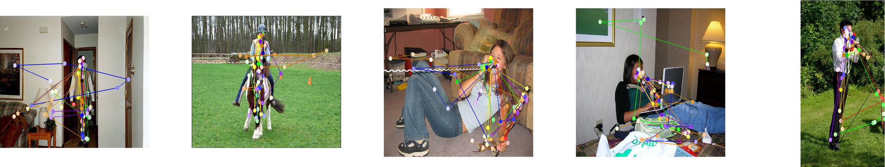
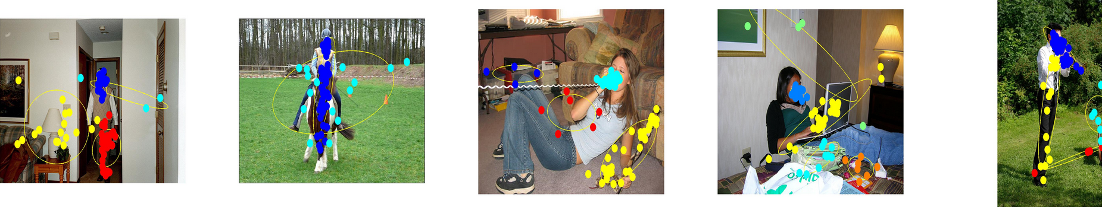
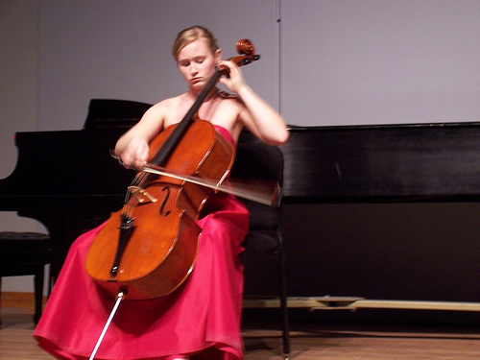
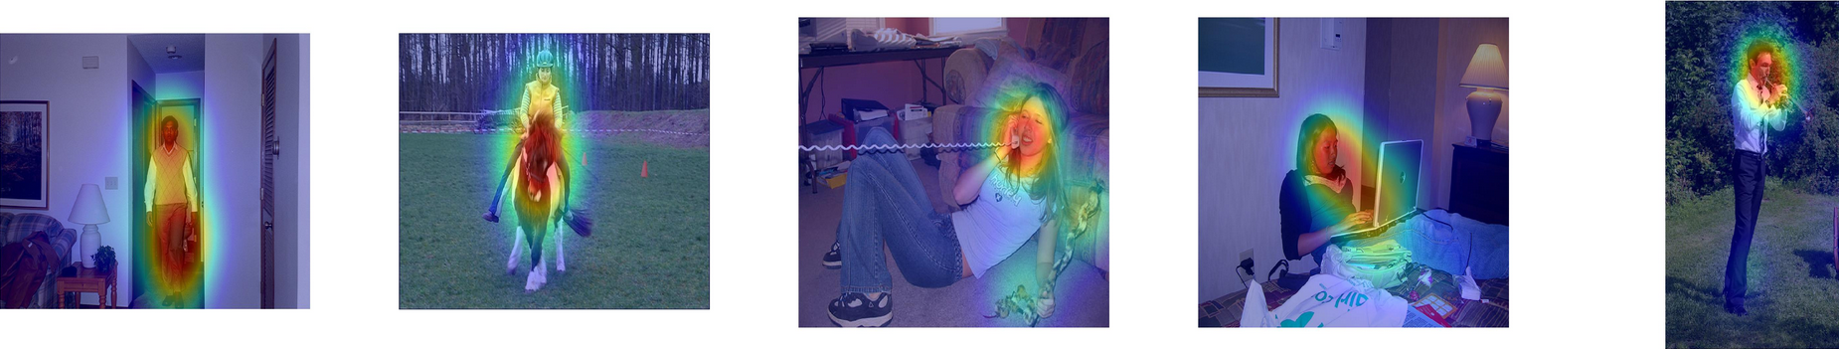
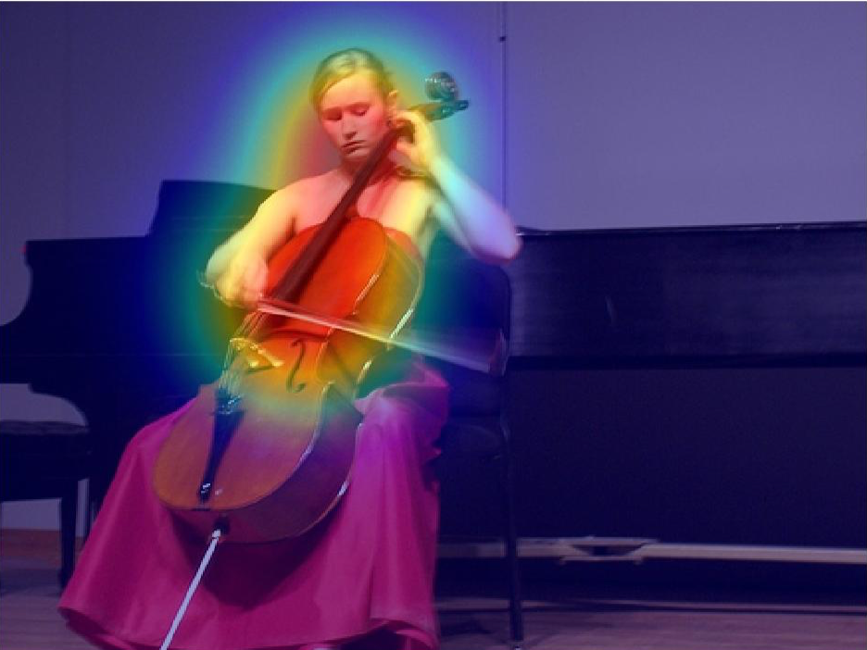
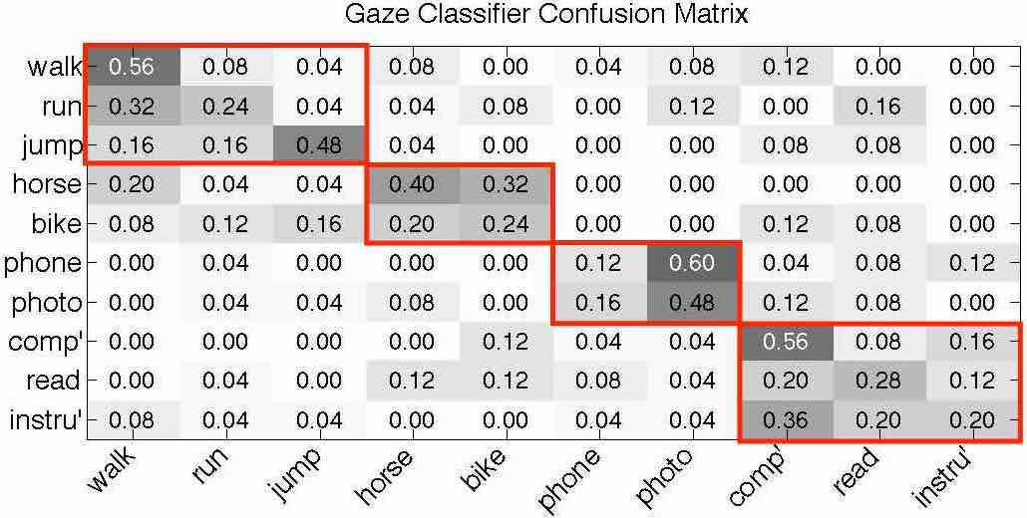
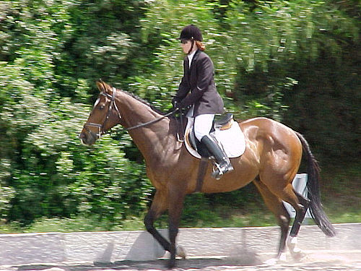
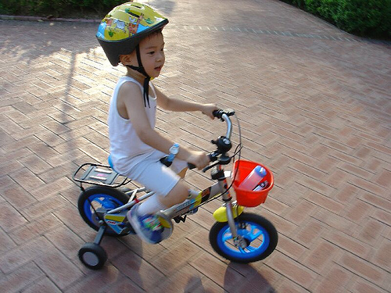
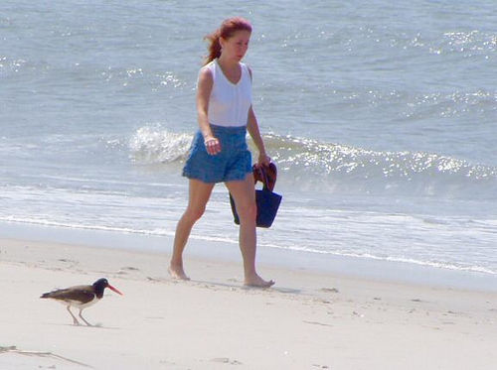
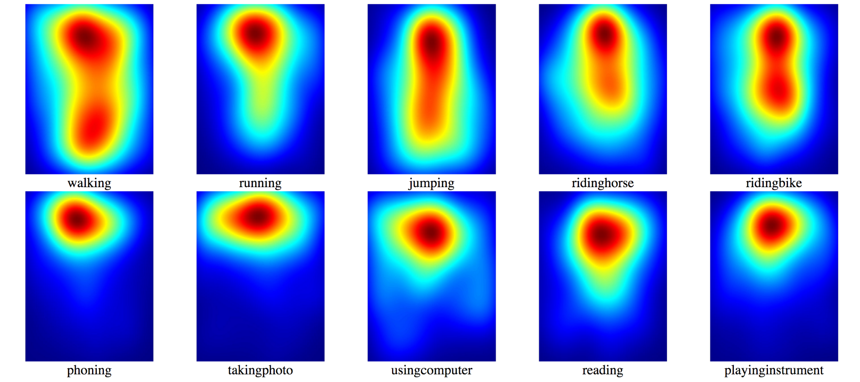
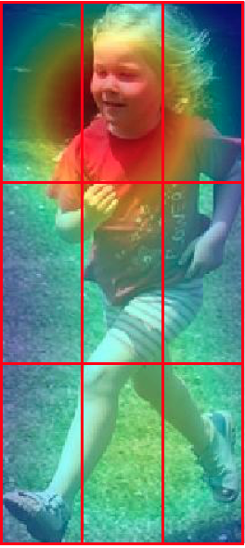
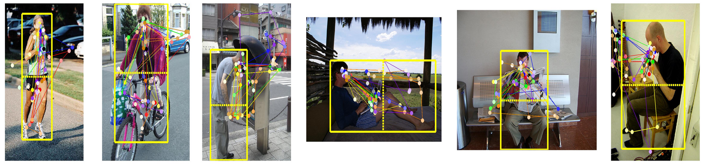
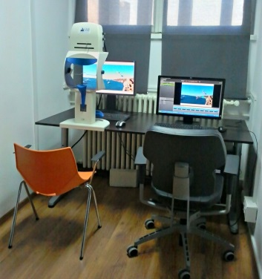
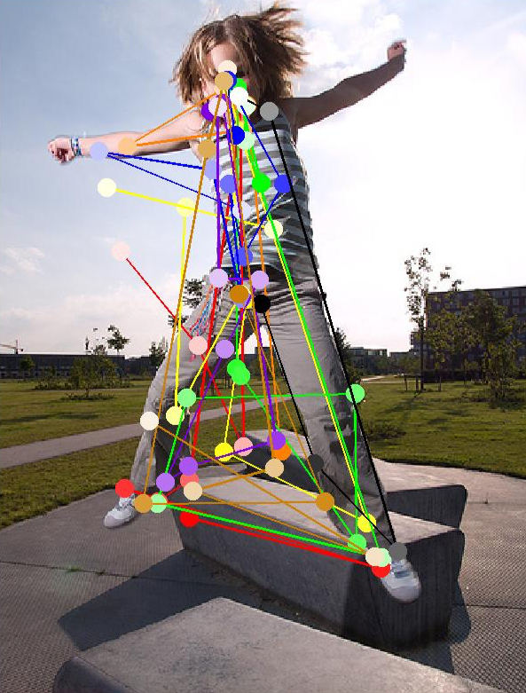
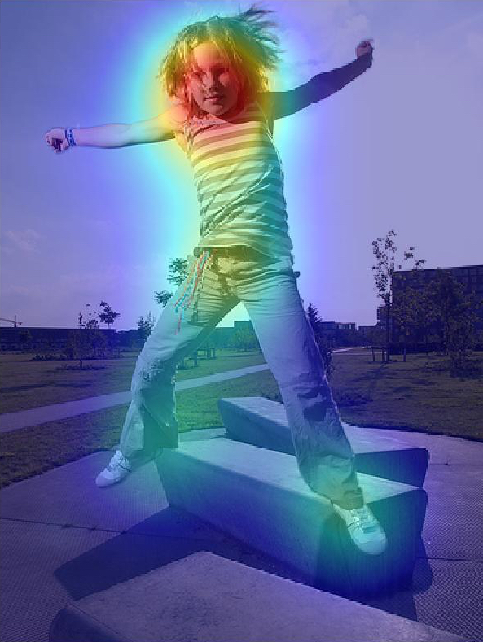
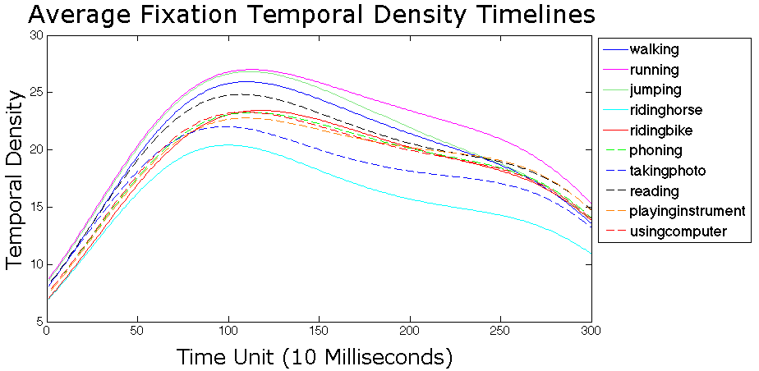
How We Look Tells Us What We Do: Action Recognition Using Human Gaze Kiwon Yun¹, Gary Ge², Dimitris Samaras¹, Gregory J. Zelinsky^{1,3} ¹Department of Computer Science, Stony Brook University, ²Ward Melville High School, ³Department of Psychology, Stony Brook University
Overview
Experiments & Analyses
Human eye movement patterns (gaze) contain information that can be used to recognize actions in still images and enhance automatic computer vision methods.
Finding gaze patterns with visualization
Classification results for 10 action classes
Support Vector Machine (SVM) classifiers trained for gaze and CNN features.
2 different versions of baseline: CNN and CNN-MultiReg.
Gaze and baseline combined by summing weighted confidence scores.
Eye Movement Patterns
Different action classes elicit different spatio-temporal patterns from viewers’ gaze.
Features are derived from patterns to train Support Vector Machine (SVM) classifiers.
Confusion in the gaze classifier reveals behaviorally-meaningful action groups.
 | Gaze Features | CNN | CNN-MultiReg | Gaze + CNN | Gaze + CNN-MultiReg
walk | 46.72 | 35.22 | 58.03 | 35.22 | 58.03
run | 41.75 | 74.69 | 77.7 | 74.68 | 77.7
jump | 41.65 | 74.03 | 87.47 | 78.59 | 87.47
horse | 70.63 | 91.22 | 98.41 | 92.99 | 94.75
bike | 34.15 | 98.7 | 96.63 | 98.7 | 96.63
phone | 47.58 | 36.2 | 49.29 | 36.2 | 49.29
photo | 46.24 | 42.53 | 57.94 | 42.54 | 57.94
comp’ | 38.74 | 74.34 | 72.84 | 74.34 | 72.84
read | 35.01 | 59.73 | 58.46 | 60.19 | 58.46
instru’ | 36.08 | 60.95 | 67.24 | 60.96 | 67.24
mAP | 43.86 | 64.76 | 72.4 | 65.44 | 72.04
Computer Vision
Convolutional Neural Network features are automatically computed for an image and are used to train SVM classifiers.
Aggregate fixations from all subjects, with darker circles denoting earlier fixations.
Goal
Discover the relationship between human gaze and actions in images.
Show usefulness of gaze, alone or combined with computer vision, to classify images.
CNN features
Baseline Classifier
Confidence Scores
Confidence Score Combination
Fixations clustered with a Gaussian Mixture Model.
Gaze features
Gaze Classifier
Average Precisions (APs) for classification of 10 actions. Higher APs are bolded.
Fixation Density Maps (FDMs) using 2D Gaussian distributions weighted by fixation duration.
Gaze Classifier Confusion Matrix
Contribution
Understand how people comprehend and group actions through gaze.
Propose novel gaze features for automatic action classification in still images.
Gaze Features
Different sets of segments used (9 regions, upper-body/lower-body/context).
Fixation Density Maps (FDMs) generated by placing duration-weighted 2D Gaussian distribution where each fixation occurs.
Transitions between upper-body, lower body, and context segments are measured.
Temporal Density Timelines generated by placing duration-weighted Gaussian distributions at each timestamp where a fixation occurs in the human bounding box.
Datasets
PASCAL VOC 2012 Action Classes
The confusion matrix shows four groups of commonly-confused classes that are behaviorally meaningful. We retrain classifiers to discriminate between these groups.
500 selected images from a total of 9157 images featuring:
10 action classes: “walking”, “running”, “jumping”, “riding horse”, “riding bike”, “phoning”, “taking photo”, “using computer”, “reading”, and “playing instrument”.
One whole human performing an action per image.
Average FDMs for each action class, and the 9 segments from which features are extracted.
Classification results for four class groups
SVM classifiers were retrained to discriminate between four class groups:
walking + running + jumping
riding horse + riding bike
phoning + taking photo
using computer + reading + playing instrument
Gaze Data
Gaze Tracking
Gaze Data
Visualization
Gaze transitions measured between upper-body, lower-body and context segments.
 | Gaze Features | CNN | CNN-MultiReg | Gaze + CNN | Gaze + CNN-MultiReg
walk + run + jump | 80.33 | 86.39 | 88.72 | 92.29 | 90.21
horse + bike | 79.21 | 97.53 | 97.63 | 98.99 | 98.32
phone + photo | 81.64 | 61.13 | 65.35 | 76.09 | 76.36
comp’ + read + instru’ | 83.48 | 92.21 | 92.32 | 93.93 | 94.10
mAP | 81.17 | 84.32 | 86.01 | 90.33 | 89.75
Gaze Feature | Dim.
9 Region (FDM mean/max) | 18
9 Region (transitions) | 36
Upper/Lower/Context (fixation duration) | 3
Upper/Lower/Context (transitions) | 3
Temporal Density Timeline (mean/max) | 12
12 subjects (5 male and 7 female)
3 second viewing period.
Only 8 subjects tasked with action recognition are used. 4 with context recognition are not used.
First fixations are discarded, since subjects were told to start by fixating the center of each image.
Average Temporal Density Timelines. We take the mean and maximum value from six equal segments.
Summary of feature types and dimensions.
Average Precisions (APs) for classification of four class groups. A combination of gaze and CNN features performs best overall. Higher APs are bolded.
Acknowledgements
This work was supported in part by NSF grants IIS-1161876, IIS-1111047, and the the SubSample Project by the DIGITEO institute, France. We thank Minh Hoai for providing precomputed CNN features.

